Slide 1

IAG Take Home Exercise
Analytics Engineer
Carol Moynham
July 2025

Slide 2


Slide 3
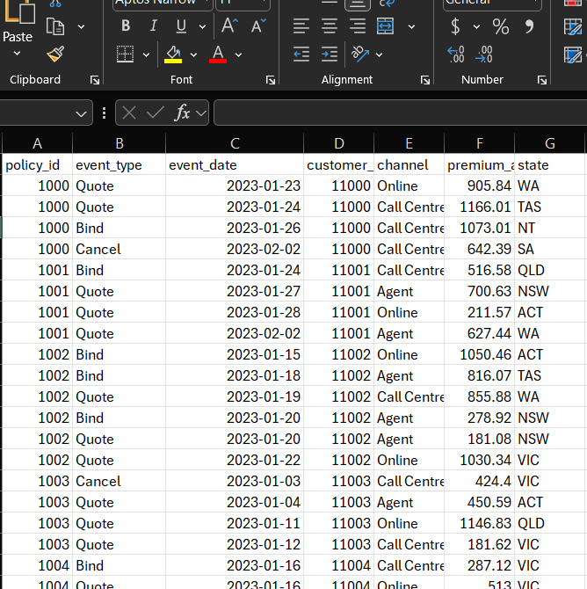

The ask: transform raw data into a clean, queryable, meaningful source for downstream users*
* Note: Models (SQL), Documentation (.yml) and sample Airflow DAG (Python) located here:
https://github.com/C-Monsta/IAG-Take-Home-Test/tree/main/

Slide 4




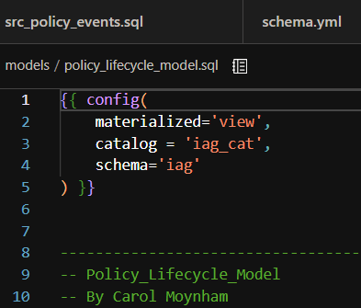
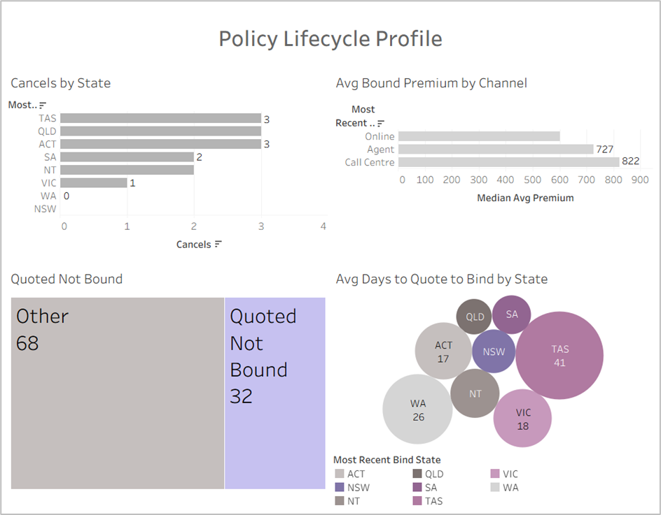
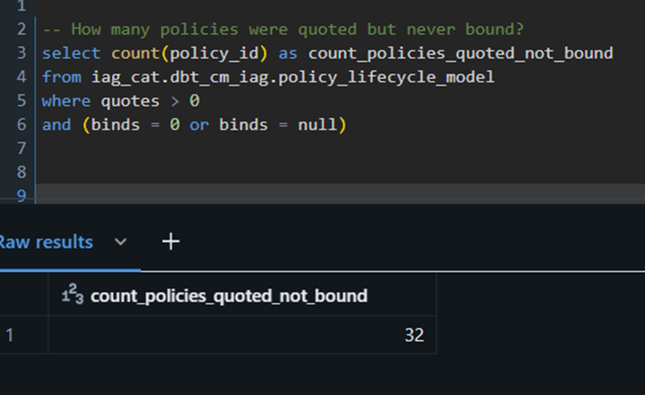

Four steps to transform raw data into a clean, queryable, meaningful source for downstream users
Set Up
Think
Model
Query and Share
Profile.yml
DB Token
Re-read the exercise
Explore the data
Conceptualise model
Assumptions
Start by creating a source table with the raw data
Build the quote bind model to address need for specific journeys in this space
Summary profile_lifcycle_model
Documentation in schema.yml
Queries in DataBricks
Self-serve dashboard
Create accounts for DBT, DataBricks, GitHub
Create workspace and schema
Load Policy data into Databricks
Connect DBT, Data Bricks, GitHub
Credentials stored in profile.yml
Document and Test across every stage

Slide 5

Data Anomalies and Assumptions
Issue/ Anomaly | Action/ Assumptions
Policy Lifecycle is one line per policy. Some of the more granular detail will be lost | For more detailed querying the deeper models can be used
State of the sale can vary by quote and bind | For reporting use the most recent quote/ bind. For historic performance, the larger src table can be referenced
Some cancels have no bind action | Investigate these and determine why, for now exclude or flag
Some bind premiums values will be null as not all policies were bound. Should these be reformatted to 0? | Leaving as null so it’s clear the policy wasn’t bound, as opposed to having 0 premium. Can be defaulted to 0 during calculated fields as needed
How to manage multiple quotes on the same day | Currently this field is date only. DateTime would show different quotes on the same day. A unique quote ID may be another option
Data source structure | These are currently set to create a materialized view. Would need to explore how often policy details change, incremental or upsert may be more efficient
PII and access | Assuming all analysts need access to PII like policy numbers. If not these can be hashed or managed with access permissions Access details sorted in profile.yml or similar. Not hard-coded
Automated checks | Some checks are built into schema.yml to ensure data accuracy, e.g. policy number must be a unique value Notifications can be set up during orchestration in case of data fail or re-run
End goal based on use case
Data management and enrichment
Governance

Slide 6
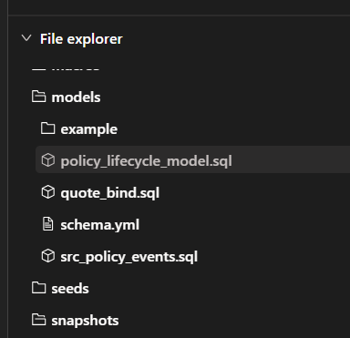
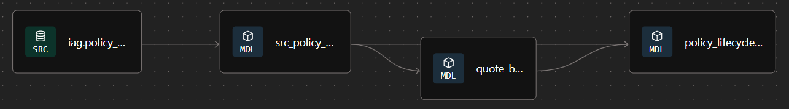
Three models built in DBT: src_policy_events, quote_bind and policy_lifecycle_model, documentation in schema.yml*
SRC_Policy_Events
Raw data
Could be cleaned or updated at this level if needed
Quote_Bind
To address the need for average time from quote to bind
Splits each quote-bind cycle into it’s own event, by policy
Policy_Lifecycle_Model
Summary combining data from source table and quote_bind
Single line per policy
Schema.yml
Documents metadata for models
Can also be used to document for seeds, sources and test
Option to automate .yml creation using AI tools like DBT Copilot (Cloud only)
* Models (SQL) located here: https://github.com/C-Monsta/IAG-Take-Home-Test/tree/main/models

Slide 7
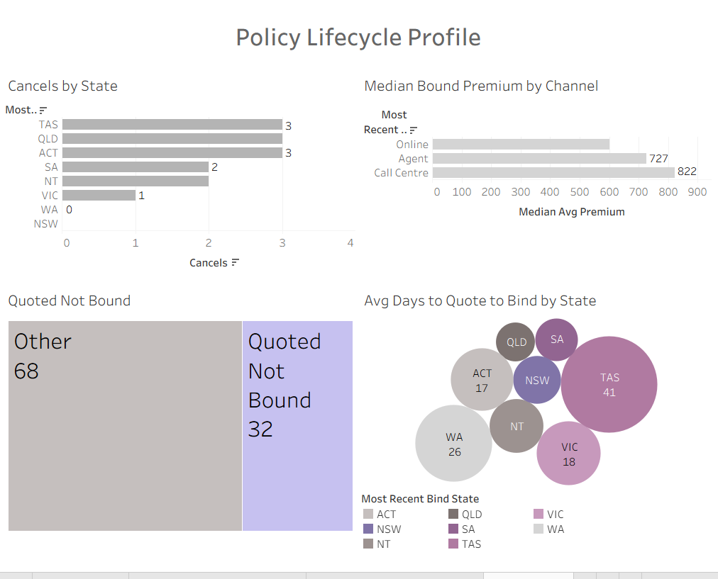
Exploring the data in Tableau
Visualisations can quickly explore and report on policy data

Slide 8
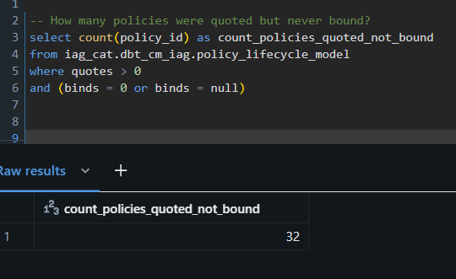
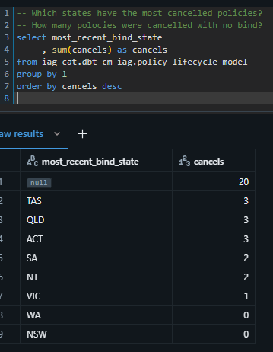
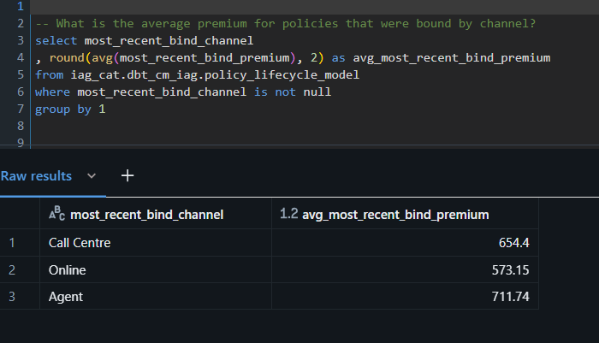
Exploring the data in SQL

Slide 9

Orchestration to automate and coordinate the data pipeline*
Airflow: Open source, flexible, widely used, python based, strong community
Sample High Level Flow
Run quote_bind
Run policy_lifecycle_model
Failed tasks?
End
Start
Run src_policy_events
No
Run additional base tables
Yes
Get_failed_tasks
(python operator)
Email task failure alert
Schedule
Sensor: dependent on src data update
* Airflow DAG (Python) located here: https://github.com/C-Monsta/IAG-Take-Home-Test/tree/main/models

Slide 10

Thank you!

Slide 11
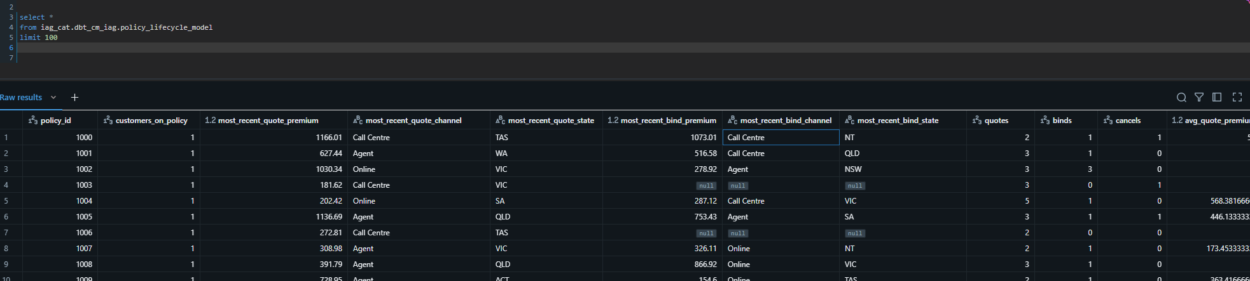
Appendix 1: Policy Lifecycle Model Sample Data
* Models located here: https://github.com/C-Monsta/IAG-Take-Home-Test/tree/main/models

Slide 12
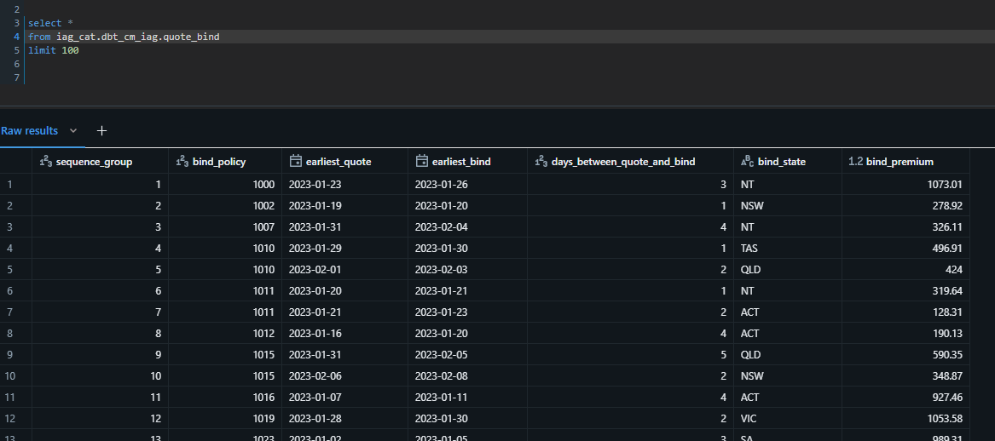
Appendix 2: Quote Bind Model Sample Data
* Models located here: https://github.com/C-Monsta/IAG-Take-Home-Test/tree/main/models

